Slide 1
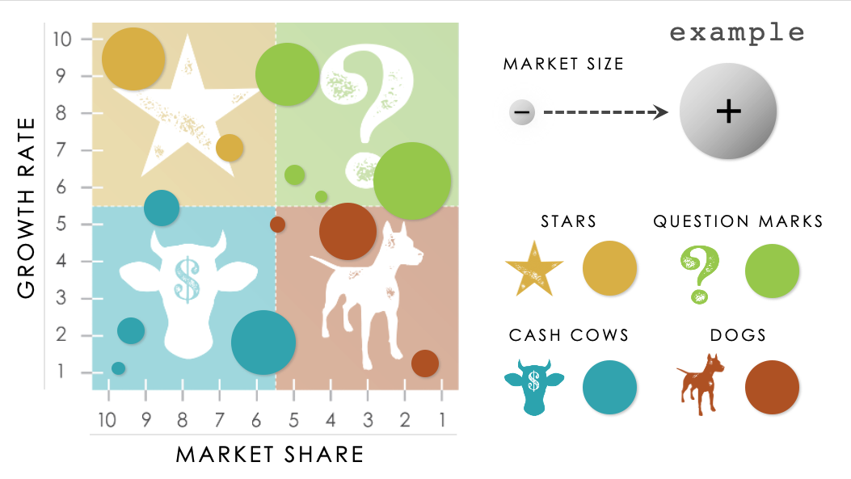
PowerPoint BCG Matrix Template
When to Use This Template: Use this template to evaluate and categorize your business units or products based on their market growth rate and market share. The insights you gain as a result of this analysis will aid in strategic decision-making.
Notable Template Highlights: This PowerPoint template is specifically designed for the BCG matrix, with customizable quadrants for Stars (high market share in high-growth markets requiring investment), Cash Cows (high market share in low-growth markets generating steady profits), Question Marks (low market share in high-growth markets needing significant investment), and Dogs (low market share in low-growth markets with limited profit potential).

Slide 2
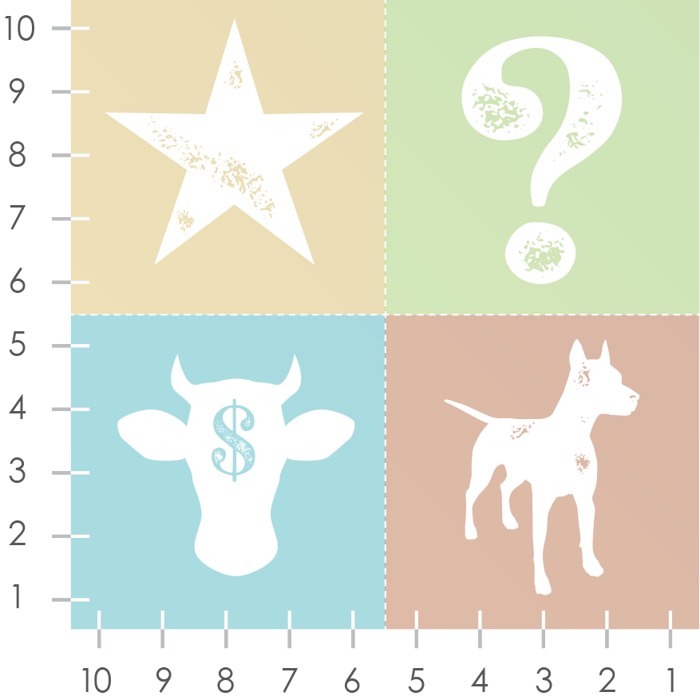
example
MARKET SIZE
+
–
GROWTH RATE
STARS
QUESTION MARKS
CASH COWS
DOGS
MARKET SHARE

Slide 3
MARKET SIZE
+
–
GROWTH RATE
STARS
QUESTION MARKS
CASH COWS
DOGS
MARKET SHARE

Slide 4
DISCLAIMER Any articles, templates, or information provided by Smartsheet on the website are for reference only. While we strive to keep the information up to date and correct, we make no representations or warranties of any kind, express or implied, about the completeness, accuracy, reliability, suitability, or availability with respect to the website or the information, articles, templates, or related graphics contained on the website. Any reliance you place on such information is therefore strictly at your own risk.

