Slide 1
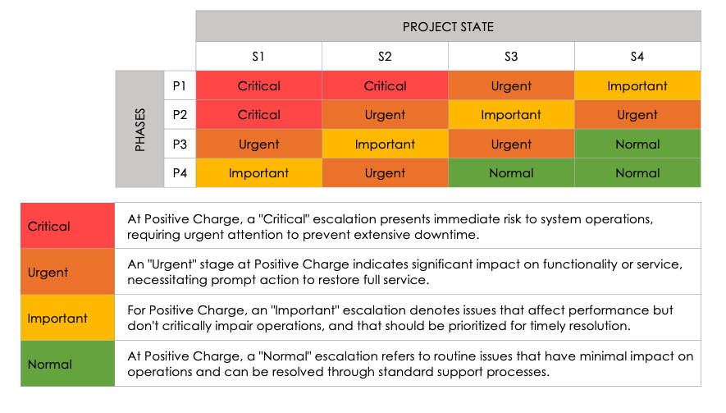
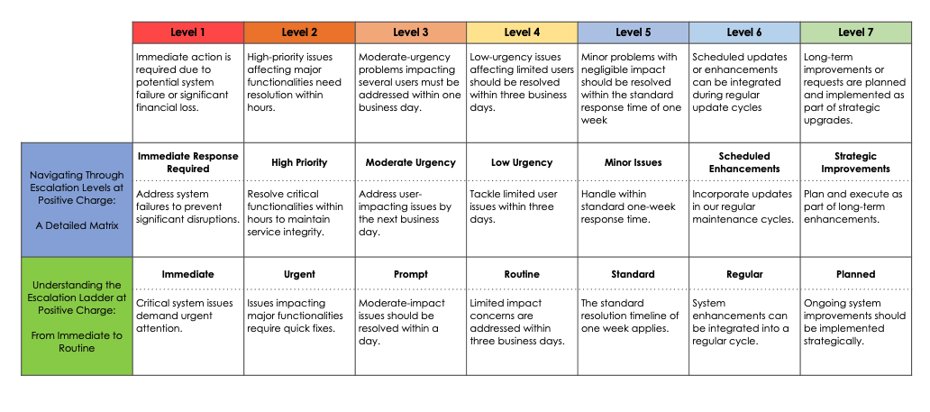
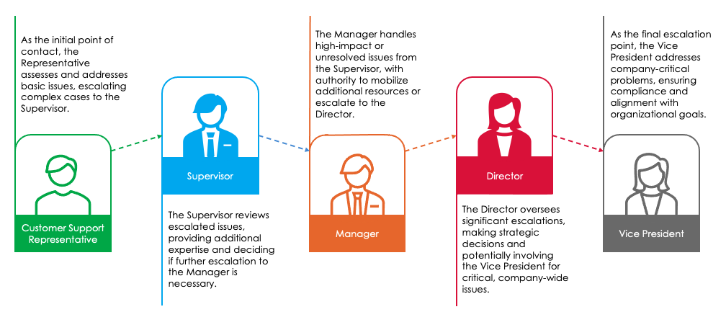
Simple Escalation Matrix Template
When To Use This Template: Use this template for straightforward, small-scale projects when you need to document a clear escalation path that is easy to follow.
Notable Templates Features: This template includes space for you to document the severity level of each project or individual issue (e.g., Critical, Urgent, Important, or Normal). You can also use this template to document the phase and specific escalation workflow.

Slide 2
Simple Escalation Matrix
You can edit this text, customize it with your escalation process details, and change the font or style.
 |  | PROJECT STATE
 |  | S1 | S2 | S3 | S4
PHASES | P1 | Critical | Critical | Urgent | Important
 | P2 | Critical | Urgent | Important | Urgent
 | P3 | Urgent | Important | Urgent | Normal
 | P4 | Important | Urgent | Normal | Normal
Critical
Urgent
Important
Normal

Slide 3
Simple Escalation Matrix
You can edit this text, customize it with your escalation process details, and change the font or style.
 | Level 1 | Level 2 | Level 3 | Level 4 | Level 5 | Level 6 | Level 7
 | Immediate action is required due to potential system failure or significant financial loss. | High-priority issues affecting major functionalities need resolution within hours. | Moderate-urgency problems impacting several users must be addressed within one business day. | Low-urgency issues affecting limited users should be resolved within three business days. | Minor problems with negligible impact should be resolved within the standard response time of one week | Scheduled updates or enhancements can be integrated during regular update cycles | Long-term improvements or requests are planned and implemented as part of strategic upgrades.
Sample text | Immediate Response Required | High Priority | Moderate Urgency | Low Urgency | Minor Issues | Scheduled Enhancements | Strategic Improvements
Sample text | Immediate | Urgent | Prompt | Routine | Standard | Regular | Planned

Slide 4
Simple Escalation Matrix
You can edit this text, customize it with your escalation process details, and change the font or style.
Sample text
Sample text
Sample text
Supervisor
Director
Sample text
Sample text
Customer Support Representative
Manager
Vice President

Slide 5
DISCLAIMER Any articles, templates, or information provided by Smartsheet on the website are for reference only. While we strive to keep the information up to date and correct, we make no representations or warranties of any kind, express or implied, about the completeness, accuracy, reliability, suitability, or availability with respect to the website or the information, articles, templates, or related graphics contained on the website. Any reliance you place on such information is therefore strictly at your own risk.

