Slide 1
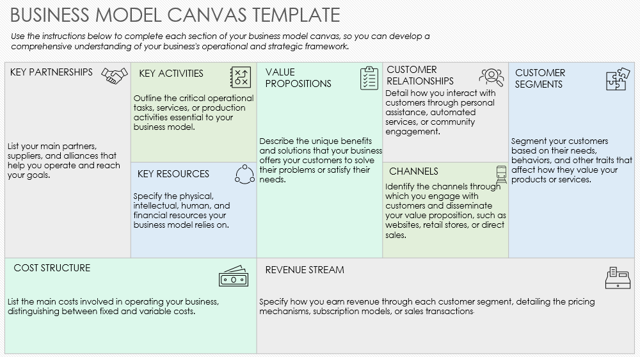
SIMPLE BUSINESS MODEL CANVAS TEMPLATE EXAMPLE

Slide 2
BUSINESS MODEL CANVAS TEMPLATE EXAMPLE
CUSTOMER RELATIONSHIPS
Collaborations with local governments for station placements, partnerships with renewable energy suppliers, and alliances with electric vehicle manufacturers. | Operation and maintenance of EV charging stations, customer service management, and continuous technological upgrades for efficient service. | Offering fast, reliable, and eco-friendly charging solutions to EV owners, with superior customer service and advanced technology. | Building loyal customer relationships through reliable service, customer loyalty programs, and responsive support. | Targeting individual EV owners, commercial fleets, and government vehicles requiring regular charging services.
 | Our network of charging stations, proprietary charging technology, skilled technical team, and customer support infrastructure. |  | Service accessibility via mobile app, online platforms for reservation and payment, and strategically located charging stations
Investments in charging station infrastructure, technology development, personnel costs, and marketing expenses. |  | Income from charging services, subscription plans for frequent users, and partnerships for station installations.
KEY PARTNERSHIPS
KEY ACTIVITIES
VALUE PROPOSITIONS
CUSTOMER SEGMENTS
KEY RESOURCES
CHANNELS
COST STRUCTURE
REVENUE STREAM

Slide 3
DISCLAIMER Any articles, templates, or information provided by Smartsheet on the website are for reference only. While we strive to keep the information up to date and correct, we make no representations or warranties of any kind, express or implied, about the completeness, accuracy, reliability, suitability, or availability with respect to the website or the information, articles, templates, or related graphics contained on the website. Any reliance you place on such information is therefore strictly at your own risk.

