Slide 1
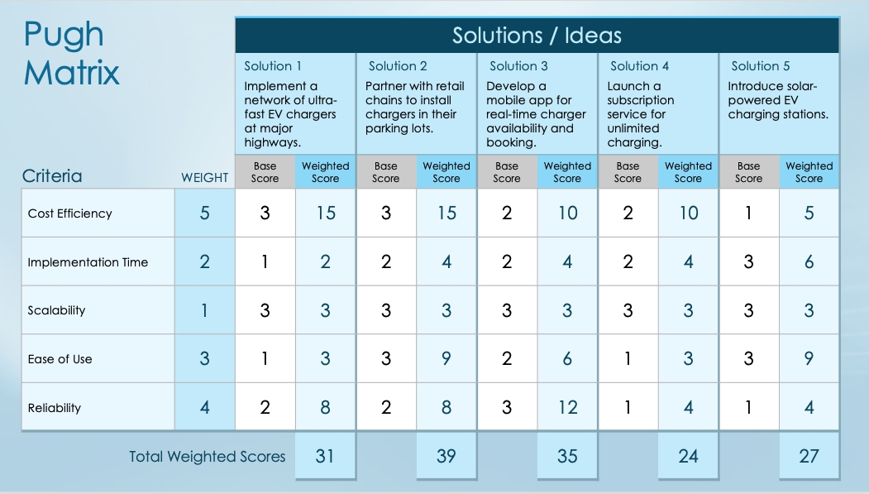
Basic Weighted Pugh Matrix Template

Slide 2
How to Complete the Pugh Matrix
1. List Solutions:
In the "Solutions / Ideas" section, enter your potential solutions.
2. Define Criteria:
Review the "Criteria" section to ensure it reflects the factors important to your evaluation. Common criteria include cost efficiency, implementation time, scalability, ease of use, reliability, maintenance requirements, customer satisfaction potential, risk level, resource availability, and alignment with objectives.
3. Assign Weights:
For each criterion, assign a weight based on its importance (e.g., 1 – 5, where 5 is the most important).
4. Score Solutions:
For each solution, assess whether it is the same, better, or worse than the current or baseline solution. In the "Base Score" column, assign 1 for worse, 2 for the same, 3 for better.
5. Calculate Weighted Scores:
Multiply the base score by the weight for each criterion. Sum these values for each solution to determine the weighted score.
6. Compare Results:
Review the total weighted sums for each solution. The solution with the highest score generally represents the best option.

Slide 3
Pugh Matrix
 |  | Solutions / Ideas
 |  | Solution 1 |  | Solution 2 |  | Solution 3 |  | Solution 4 |  | Solution 5
Criteria | WEIGHT | Base Score | Weighted Score | Base Score | Weighted Score | Base Score | Weighted Score | Base Score | Weighted Score | Base Score | Weighted Score
Total Weighted Scores

Slide 4
Conclusion
Conclusion Text

Slide 5
DISCLAIMER Any articles, templates, or information provided by Smartsheet on the website are for reference only. While we strive to keep the information up to date and correct, we make no representations or warranties of any kind, express or implied, about the completeness, accuracy, reliability, suitability, or availability with respect to the website or the information, articles, templates, or related graphics contained on the website. Any reliance you place on such information is therefore strictly at your own risk.

