Slide 1
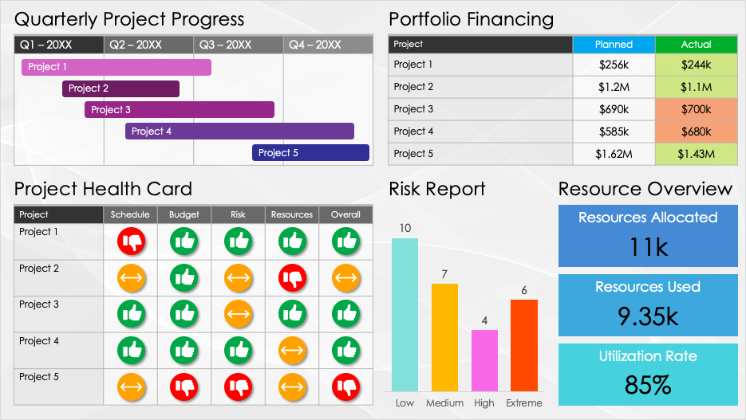
Project Portfolio Management Dashboard
Slide
Template

Slide 2
Quarterly Project Progress
Portfolio Financing
Q1 – 20XX | Q2 – 20XX | Q3 – 20XX | Q4 – 20XX
Project | Planned | Actual
Project 1 | $256k | $244k
Project 2 | $1.2M | $1.1M
Project 3 | $690k | $700k
Project 4 | $585k | $680k
Project 5 | $1.62M | $1.43M
Project 1
Project 2
Project 3
Project 4
Project 5
Project Health Card
Risk Report
Resource Overview
Project | Schedule | Budget | Risk | Resources | Overall
Project 1
Project 2
Project 3
Project 4
Project 5
Resources Allocated
11k
Resources Used
9.35k
Utilization Rate
85%

Slide 3
DISCLAIMER Any articles, templates, or information provided by Smartsheet on the website are for reference only. While we strive to keep the information up to date and correct, we make no representations or warranties of any kind, express or implied, about the completeness, accuracy, reliability, suitability, or availability with respect to the website or the information, articles, templates, or related graphics contained on the website. Any reliance you place on such information is therefore strictly at your own risk.

