Slide 1
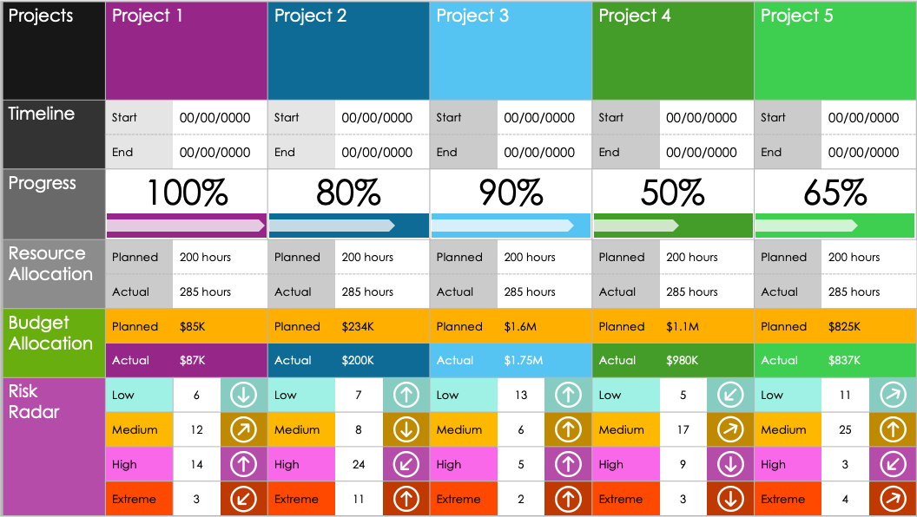
Project Portfolio Status Report Dashboard Template

Slide 2
Projects | Project 1 |  |  | Project 2 |  |  | Project 3 |  |  | Project 4 |  |  | Project 5
Timeline | Start | 00/00/0000 |  | Start | 00/00/0000 |  | Start | 00/00/0000 |  | Start | 00/00/0000 |  | Start | 00/00/0000
 | End | 00/00/0000 |  | End | 00/00/0000 |  | End | 00/00/0000 |  | End | 00/00/0000 |  | End | 00/00/0000
Progress | 100% |  |  | 80% |  |  | 90% |  |  | 50% |  |  | 65%
Resource Allocation | Planned | 200 hours |  | Planned | 200 hours |  | Planned | 200 hours |  | Planned | 200 hours |  | Planned | 200 hours
 | Actual | 285 hours |  | Actual | 285 hours |  | Actual | 285 hours |  | Actual | 285 hours |  | Actual | 285 hours
Budget Allocation | Planned | $85K |  | Planned | $234K |  | Planned | $1.6M |  | Planned | $1.1M |  | Planned | $825K
 | Actual | $87K |  | Actual | $200K |  | Actual | $1.75M |  | Actual | $980K |  | Actual | $837K
Risk Radar | Low | 6 |  | Low | 7 |  | Low | 13 |  | Low | 5 |  | Low | 11
 | Medium | 12 |  | Medium | 8 |  | Medium | 6 |  | Medium | 17 |  | Medium | 25
 | High | 14 |  | High | 24 |  | High | 5 |  | High | 9 |  | High | 3
 | Extreme | 3 |  | Extreme | 11 |  | Extreme | 2 |  | Extreme | 3 |  | Extreme | 4

Slide 3
Projects | Project 1
Timeline | Start |  |  | Start |  |  | Start |  |  | Start |  |  | Start
 | End |  |  | End |  |  | End |  |  | End |  |  | End
Progress | % |  |  | % |  |  | % |  |  | % |  |  | %
Resource Allocation | Planned | hours |  | Planned | hours |  | Planned | hours |  | Planned | hours |  | Planned | hours
 | Actual | hours |  | Actual | hours |  | Actual | hours |  | Actual | hours |  | Actual | hours
Budget Allocation | Planned | $ |  | Planned | $ |  | Planned | $ |  | Planned | $ |  | Planned | $
 | Actual | $ |  | Actual | $ |  | Actual | $ |  | Actual | $ |  | Actual | $
Risk Radar | Low |  |  | Low |  |  | Low |  |  | Low |  |  | Low
 | Medium |  |  | Medium |  |  | Medium |  |  | Medium |  |  | Medium
 | High |  |  | High |  |  | High |  |  | High |  |  | High
 | Extreme |  |  | Extreme |  |  | Extreme |  |  | Extreme |  |  | Extreme

Slide 4
DISCLAIMER Any articles, templates, or information provided by Smartsheet on the website are for reference only. While we strive to keep the information up to date and correct, we make no representations or warranties of any kind, express or implied, about the completeness, accuracy, reliability, suitability, or availability with respect to the website or the information, articles, templates, or related graphics contained on the website. Any reliance you place on such information is therefore strictly at your own risk.

