Slide 1
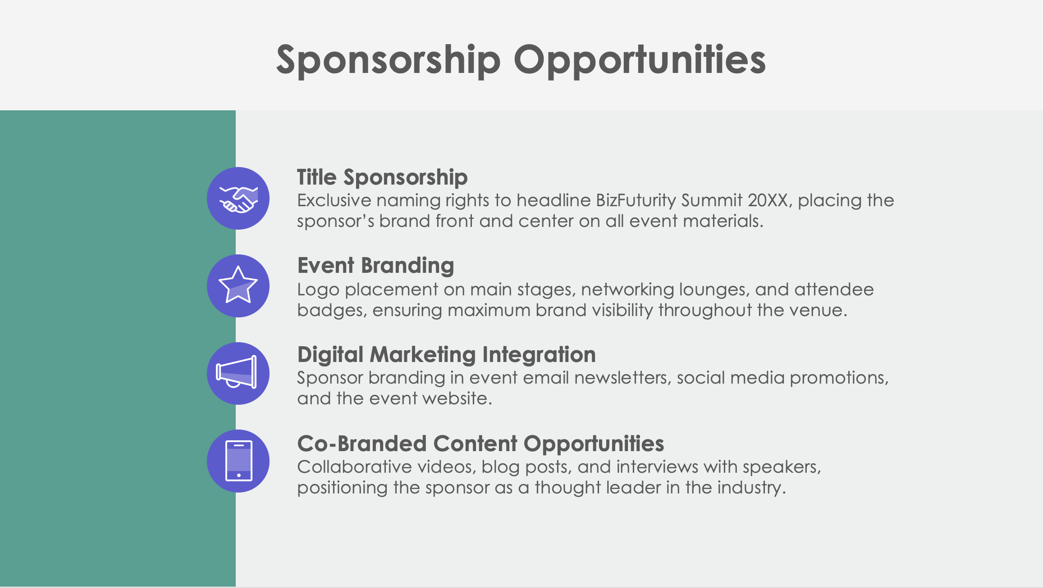
PowerPoint Corporate Sponsorship Proposal Template

Slide 2
Event or Initiative Name Sponsorship Proposal
Event Date and Location
Organization’s Name
Prepared by Name
Corporate Sponsorship Proposal

Slide 3
Contents
1 | Event or Initiative Overview
2 | About the Event, Initiative, or Organization
3 | Sponsorship Opportunities
4 | Sponsorship Benefits
5 | Sponsorship Packages
6 | Custom Sponsorship Opportunities
7 | Marketing and Promotion Plan
8 | Corporate Social Responsibility (CSR) Alignment
9 | Business Partnership Opportunities
10 | Previous Successes and Testimonials
11 | Contact Information

Slide 4
Event or Initiative Overview

Slide 5
About the Event, Initiative, or Organization
Mission
History and Key Achievements
Audience Demographics

Slide 6
Sponsorship Opportunities
Title Sponsorship
Event Branding
Digital Marketing Integration
Co-Branded Content Opportunities

Slide 7
Sponsorship Benefits
4

Slide 8
Sponsorship Packages
Platinum Package
Gold Package
Silver Package
Bronze Package
$X,XXX
$X,XXX
$X,XXX
$X,XXX

Slide 9
Custom Sponsorship Opportunities

Slide 10
Marketing and Promotion Plan
Pre-Event
During Event
Post-Event
7

Slide 11
Corporate Social Responsibility (CSR) Alignment

Slide 12
Business Partnership Opportunities

Slide 13
Previous Successes and Testimonials
In 20XX, Company Name…
attracted over
X,XXX attendees
garnered
XX,XXX+ media impressions
Feedback from previous sponsors includes:
“Quote here.”

Slide 14
Contact Information
Sponsorship Coordinator
Name
Website
Email
company.com
sponsorships@company.com
Phone
Web & Social
(555) 234-5678
Follow us on LinkedIn, X, and Facebook for event updates.

Slide 15
DISCLAIMER Any articles, templates, or information provided by Smartsheet on the website are for reference only. While we strive to keep the information up to date and correct, we make no representations or warranties of any kind, express or implied, about the completeness, accuracy, reliability, suitability, or availability with respect to the website or the information, articles, templates, or related graphics contained on the website. Any reliance you place on such information is therefore strictly at your own risk.

