Slide 1
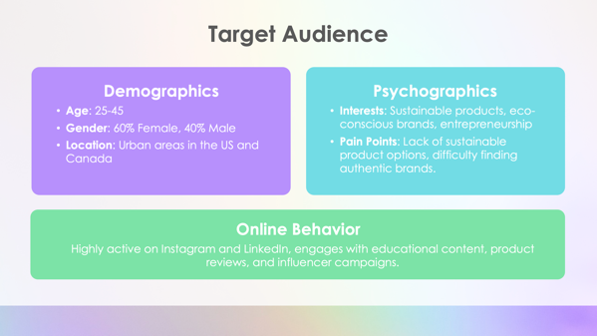
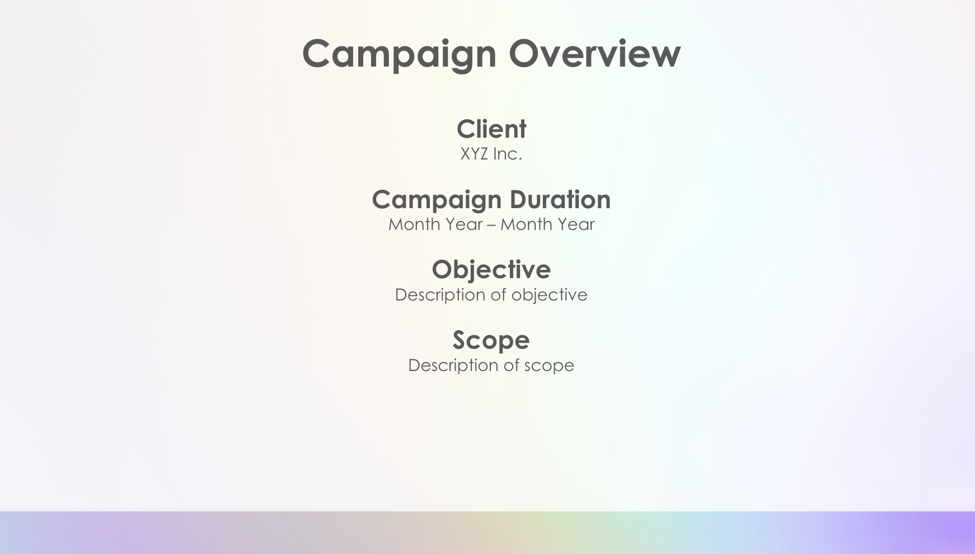
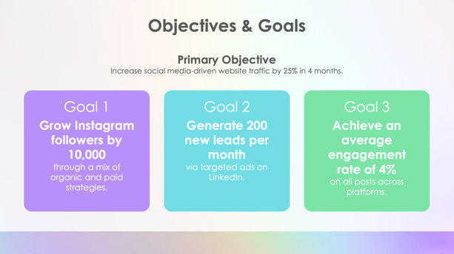
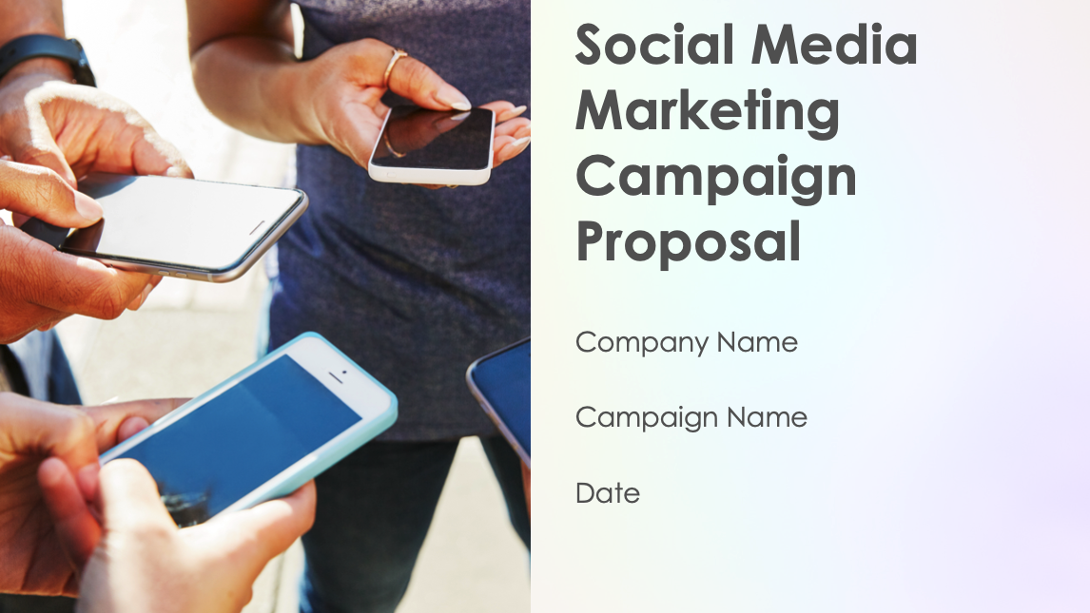
Social Media Marketing Campaign Proposal Template

Slide 2
Social Media Marketing Campaign Proposal
Company name
Campaign name
Date

Slide 3
Campaign Overview
Client
XYZ Inc.
Campaign Duration
Month Year – Month Year
Objective
Description of objective
Scope
Description of scope

Slide 4
Objectives & Goals
Primary Objective
Description of primary objective
Goal 1
Grow Instagram followers by XXXXX through a mix of organic and paid strategies.
Goal 2
Generate XXX new leads per month via targeted ads on LinkedIn.
Goal 3
Achieve an average engagement rate of X% on all posts across platforms.

Slide 5
Target Audience
Demographics
Age:
Gender: XX% female, XX% male
Location:
Psychographics
Interests:
Pain Points:
Online Behavior
Description of online behavior

Slide 6
Competitive Analysis
Competitors Analyzed
Company names
Key Insights
Company Name has strong Instagram engagement but limited presence on LinkedIn.
Company Name dominates Facebook ads but lacks consistent organic content.
Company Name influencer campaigns have increased their visibility but have low conversion rates.
Opportunities
Description of opportunities

Slide 7
Marketing Reach by Channel
Facebook
Reach last year
XXX,XXX
Customer acquisitions
XXX
Top-performing channel for retargeting ads (X% conversion rate)
Instagram
Reach last year
XXX,XXX
Customer acquisitions
XXX
Best for brand awareness and community engagement (X% engagement rate)
LinkedIn
Reach last year
XXX,XXX
Customer acquisitions
XXX
High-quality leads and B2B connections

Slide 8
Content Strategy
Content Pillars
Educational
(Sustainability tips, industry trends)
Promotional
(New products, special offers)
User-Generated Content
(Customer stories, testimonials)
Influencer Partnerships
(Micro-influencers in the eco-friendly space)
Formats
Instagram reels, stories, and static posts;
LinkedIn articles and infographics;
Facebook video ads

Slide 9
Channel Strategy
Facebook
Description of strategy
Instagram
Description of strategy
LinkedIn
Description of strategy

Slide 10
Campaign Timeline
Description
Description
Description
Description
Description
Description
Description
Description
Description
November–December
December–January
January–February
February–March

Slide 11
Cost Breakdown
Total campaign cost
$XX,XXX
Paid ads
$XX,XXX
Content creation
$XX,XXX
Influencer marketing
$X,XXX
Analytics & reporting
$X,XXX
Management fees
$X,XXX
Payment terms
XX% upfront, XX% on completion

Slide 12
Metrics & Reporting
KPIs Tracked
List of tracked KPIs
Tools Used
List of tools used

Slide 13
Next Steps
Sign contract
Confirm approval to proceed with campaign execution.
Kickoff meeting
Schedule a meeting within the first week to align on content and ads.
Campaign launch
Set the go-live date for all platforms.

Slide 14
DISCLAIMER Any articles, templates, or information provided by Smartsheet on the website are for reference only. While we strive to keep the information up to date and correct, we make no representations or warranties of any kind, express or implied, about the completeness, accuracy, reliability, suitability, or availability with respect to the website or the information, articles, templates, or related graphics contained on the website. Any reliance you place on such information is therefore strictly at your own risk.

