Slide 1
PowerPoint Event Sponsorship Proposal Template Example
ANNUAL TECH EXPO 20XX
Event Date: September 5-7, 20XX
Prepared by: Joe Girardi
Prepared for: Weller Corp.
YOUR LOGO HERE

Slide 2
CONTENTS
1
EVENT OVERVIEW
6
MARKETING AND PROMOTION PLAN
2
7
SPONSORSHIP OPPORTUNITIES
OBJECTIVES AND GOALS
8
TESTIMONIALS AND PAST SUCCESS
3
AGENDA / ITINERARY
4
9
CONTACT INFORMATION AND CALL TO ACTION
VENUE AND LAYOUT
5
BUDGET OVERVIEW

Slide 3
1. EVENT OVERVIEW
Write a brief introduction to the Tech Expo, highlighting its role as a premier event for showcasing technological advancements and fostering industry networking.
Event’s Lifecycle
PROCESS STAGE 1 Title
Description.
PROCESS STAGE 2 Title
Description.
PROCESS STAGE 3 Title
Description.
PROCESS STAGE 4 Title
Description.
PROCESS STAGE 5 Title
Description.
PROCESS STAGE 6 Title
Description.
Build a flowchart that aligns with the hierarchy of your event structure or cycle, illustrating the event’s lifecycle.

Slide 4
2. OBJECTIVES AND GOALS
GOAL 1 | Connecting innovators
GOAL 2 | Launching new products
GOAL 3 | Facilitating industry discussions
GOAL 4 | Identifying future tech trends
GOAL 3: Description

Slide 5
3. AGENDA / ITINERARY
TODAY
TASKS | DAY 1 | DAY 2 | DAY 3 | DAY 4 | DAY 5 | DAY 6
Keynote Address
New Product Launches
Industry Roundtables and Discussions
Future Tech Trends
Task 5
Task 6
Task 7
Task 8
Task 9
Task 10
9 AM–12 PM
12 PM–4 PM
9 AM–4 PM
2 PM–4 PM
Tech Leadership
Industry Professionals
Task Owner 5
Task Owner 7
Tech Companies A and B
Tech Companies C and D
Task Owner 6
Task Owner 8

Slide 6
4. VENUE AND LAYOUT
Provide details regarding the Silicon Valley Convention Center, complete with tech demo areas and networking lounges.
Replace with images, layouts, and photos related to your event venue and layout.

Slide 7
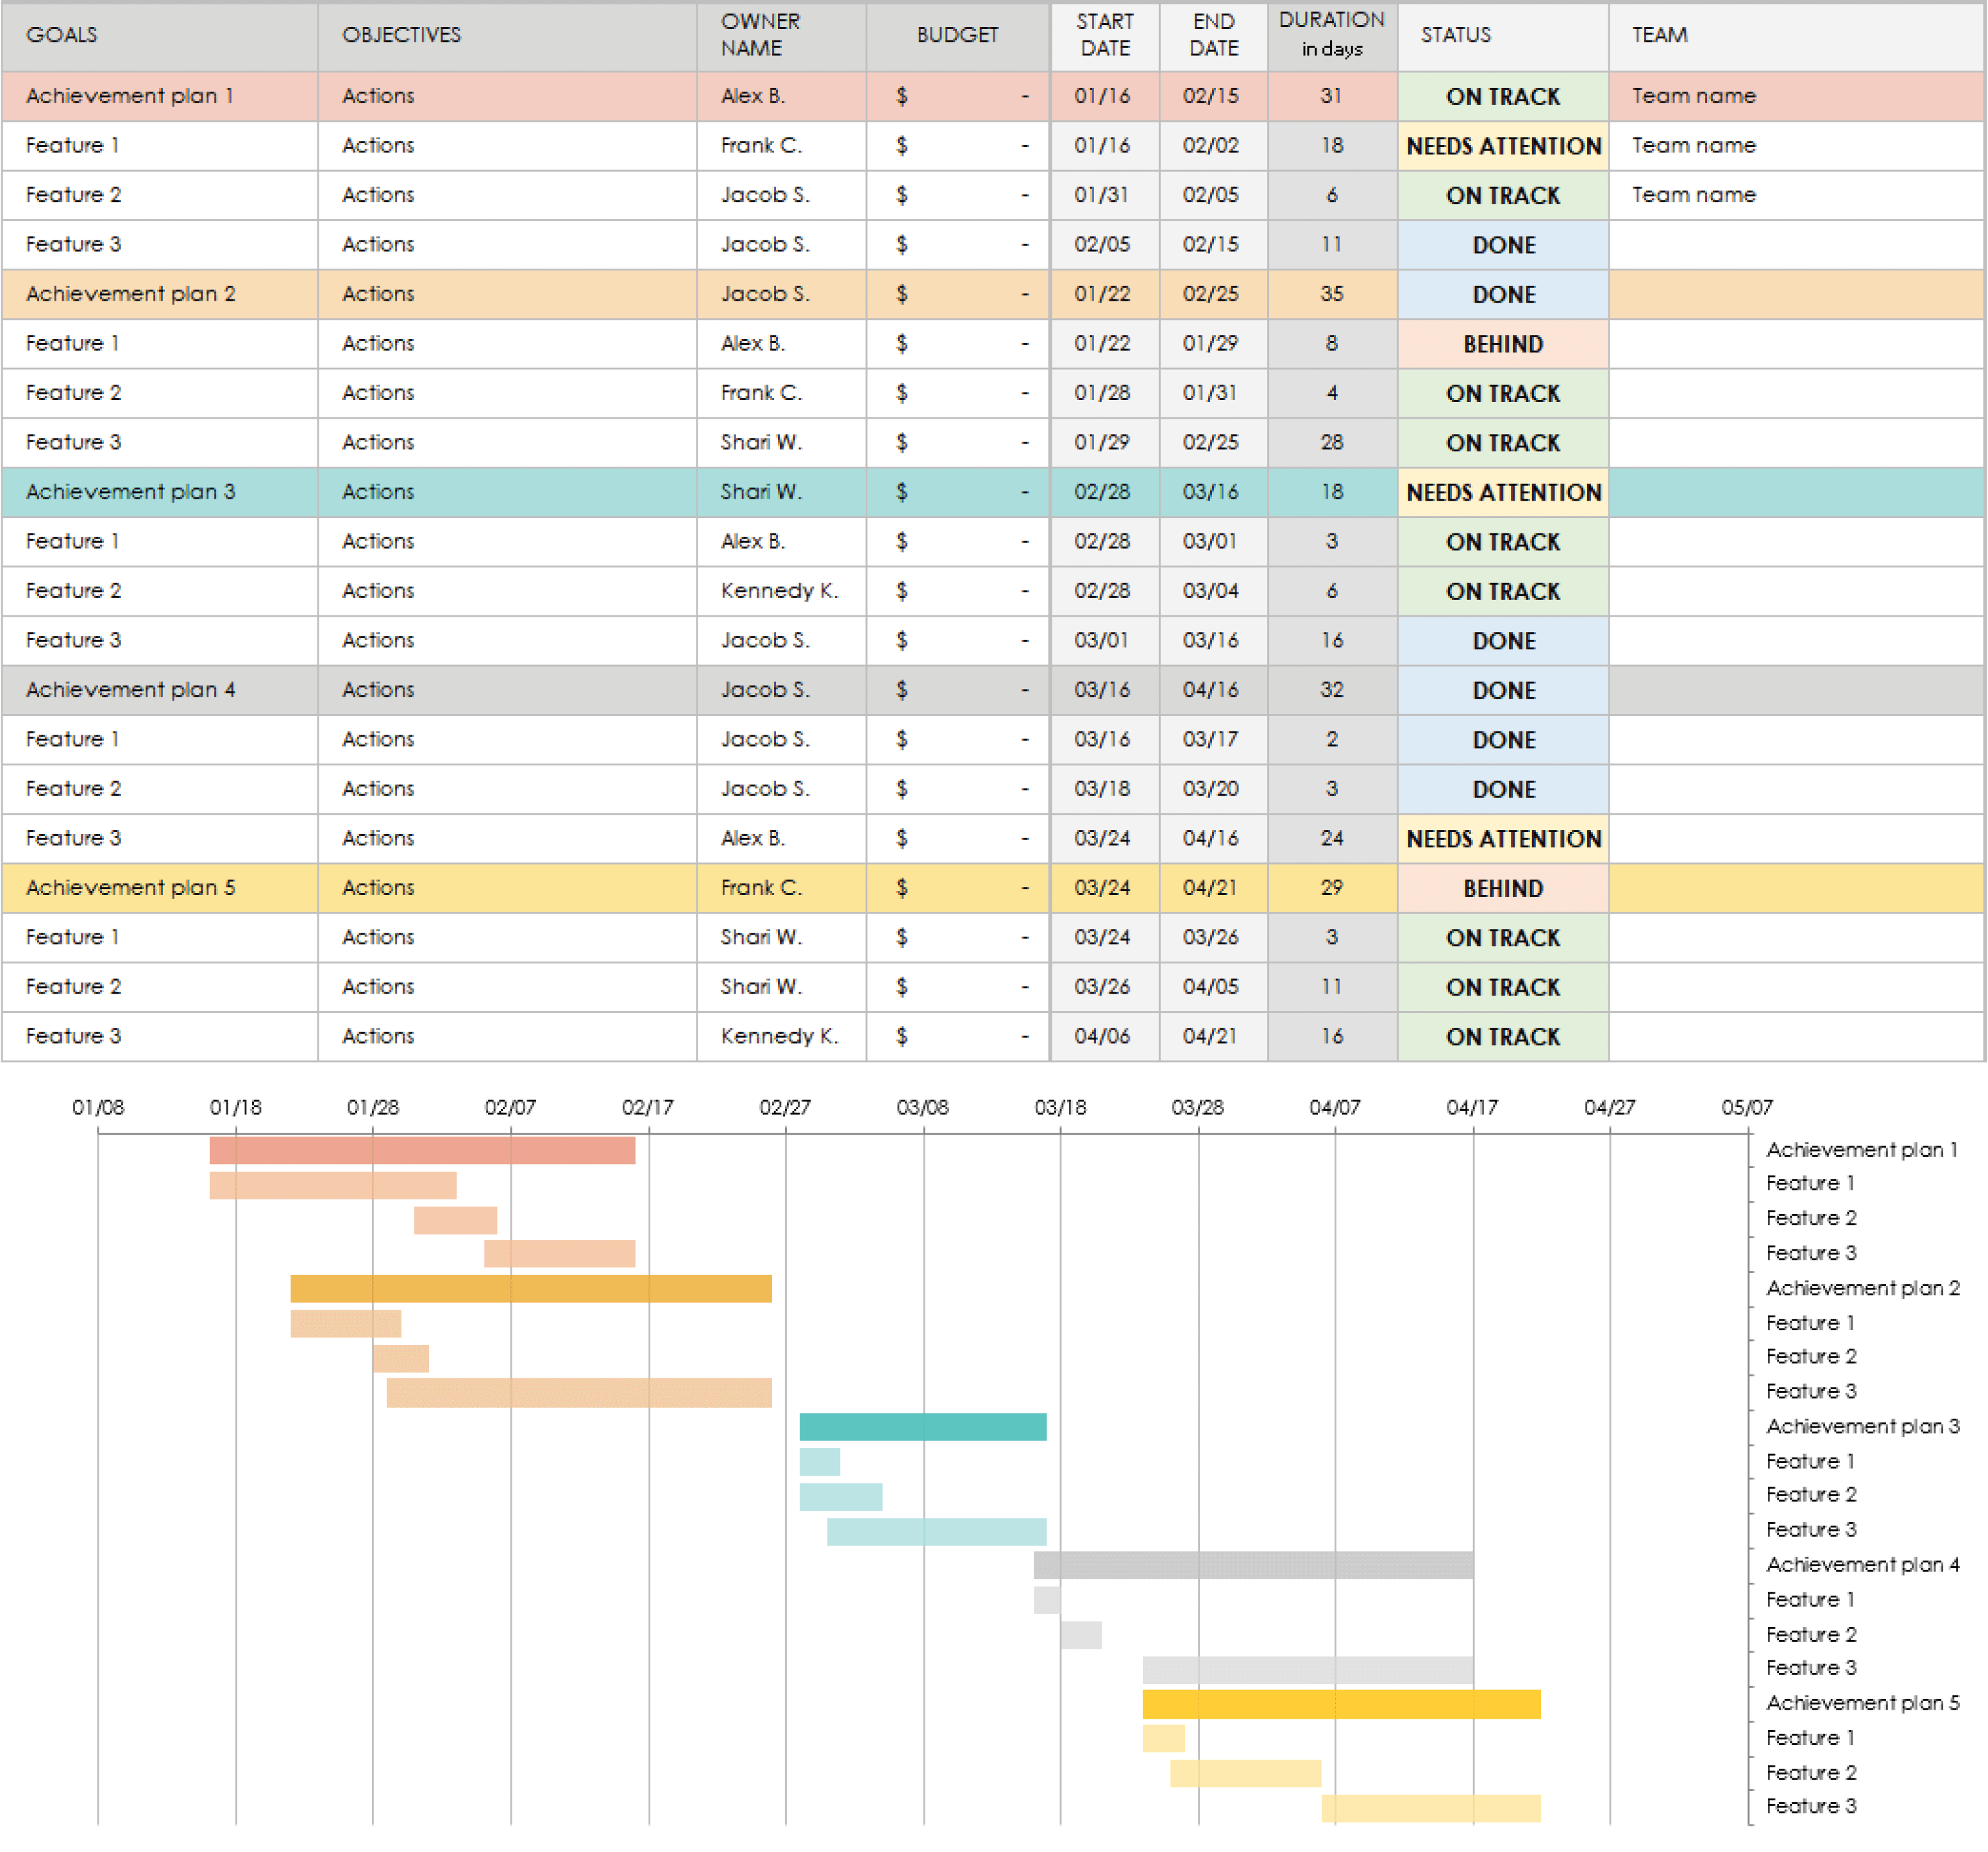
5. BUDGET OVERVIEW
Build your event budget spreadsheet in Excel, with tables, charts, etc. Then, embed the file here and/or include a static image of the Excel spreadsheet.

Slide 8
6. MARKETING AND PROMOTION PLAN
Describe your multi-platform marketing campaign, including digital media, influencer partnerships, and live event teasers.
Replace with images or videos of promotional materials directly related to your marketing plan.

Slide 9
7. SPONSORSHIP OPPORTUNITIES
Outline various sponsorship packages, including benefits for each level.
PACKAGE A | Digital ad space
PACKAGE B | Exhibit booths
PACKAGE C | Branded sponsorships
PACKAGE D | All benefits

Slide 10
8. TESTIMONIALS AND PAST SUCCESS
Sponsoring Tech Expo 20XX was rewarding and benefitted our growing partnerships.
- Bernie Williams, Package C Sponsor Tech Expo 20XX
Replace with testimonials and/or images from past events and quotes from past sponsors or attendees.

Slide 11
9. CONTACT INFORMATION AND CALL TO ACTION
Detail how to proceed with sponsoring or participating in this event…
ANNUAL TECH EXPO 20XX
Event Date: MM/DD/YY
Website
Tech Expo Social Media Information
Person of Contact: Joe Girardi, Tech Expo VP
Phone
Email
Address
Insert QR code
YOUR LOGO HERE

Slide 12
DISCLAIMER Any articles, templates, or information provided by Smartsheet on the website are for reference only. While we strive to keep the information up to date and correct, we make no representations or warranties of any kind, express or implied, about the completeness, accuracy, reliability, suitability, or availability with respect to the website or the information, articles, templates, or related graphics contained on the website. Any reliance you place on such information is therefore strictly at your own risk.

