Slide 1
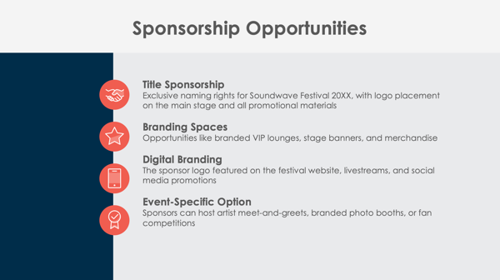
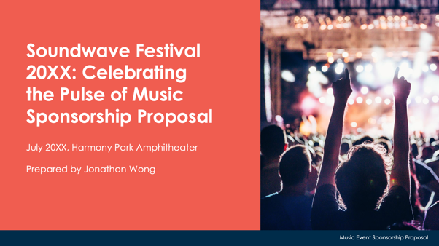
PowerPoint Music Event Sponsorship Proposal Template

Slide 2
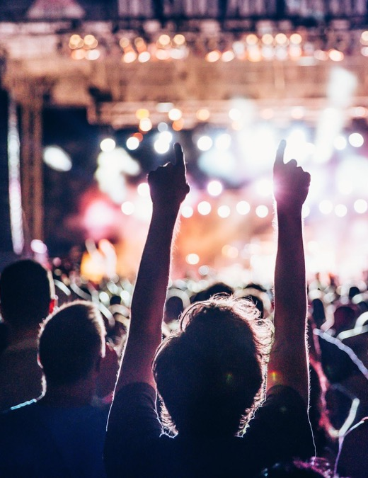
Event Name Sponsorship Proposal
Event Date and Location
Organization’s Name
Prepared by Name
Music Event Sponsorship Proposal

Slide 3
Contents
1 | Event Overview
2 | About the Event
3 | Sponsorship Opportunities
4 | Sponsorship Benefits
5 | Sponsorship Packages
6 | Custom Sponsorship Opportunities
7 | Marketing and Promotion Plan
8 | Music and Fan Engagement Opportunities
9 | Previous Successes and Testimonials
10 | Contact Information

Slide 4
Event Overview

Slide 5
About the Event
Event Date and Location
Expected Attendance
Key Highlights
2

Slide 6
Sponsorship Opportunities
Title Sponsorship
Branding Spaces
Digital Branding
Event-Specific Option

Slide 7
Sponsorship Benefits
4

Slide 8
Sponsorship Packages
Platinum Package
Gold Package
Silver Package
Bronze Package
$X,XXX
$X,XXX
$X,XXX
$X,XXX

Slide 9
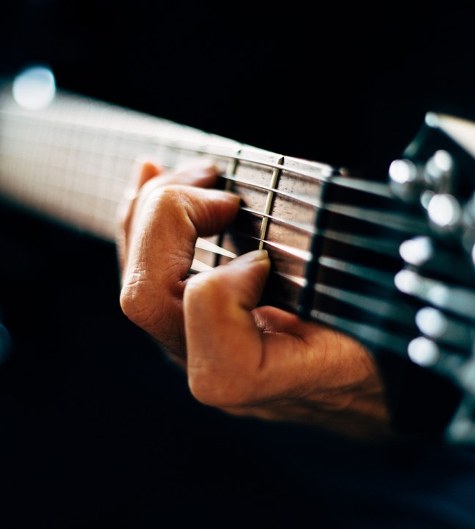
Custom Sponsorship Opportunities

Slide 10
Marketing and Promotion Plan
Pre-Event
During Event
Post-Event
7

Slide 11
Music and Fan Engagement Opportunities
Fan Zones
Meet-and-Greet Sessions
VIP Lounges
Competitions and Giveaways

Slide 12
Previous Successes and Testimonials
In 20XX, the Name of Festival…
hosted over
XX,XXX+ attendees
garnered
XXX,XXX+ media impressions
Feedback from previous sponsors includes:
“Quote here.”

Slide 13
Contact Information
Sponsorship Coordinator
Name
Website
Email
company.com
sponsorships@company.com
Phone
Web & Social
(555) 789-1234
Follow us on Instagram, Facebook, and X for event updates.

Slide 14
DISCLAIMER Any articles, templates, or information provided by Smartsheet on the website are for reference only. While we strive to keep the information up to date and correct, we make no representations or warranties of any kind, express or implied, about the completeness, accuracy, reliability, suitability, or availability with respect to the website or the information, articles, templates, or related graphics contained on the website. Any reliance you place on such information is therefore strictly at your own risk.

