Slide 1
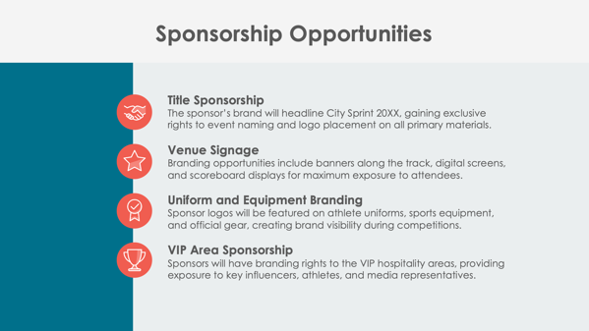
PowerPoint Sports Sponsorship Proposal Template

Slide 2
Event Name: Sponsorship Proposal
Event Date and Location
Organization’s Name
Prepared by Name
PowerPoint Sports Sponsorship Proposal

Slide 3
Contents
1 | Event Overview
2 | About the Event
3 | Sponsorship Opportunities
4 | Sponsorship Benefits
5 | Sponsorship Packages
6 | Custom Sponsorship Opportunities
7 | Marketing and Promotion Plan
8 | Audience Reach and Media Coverage
9 | Sponsor Activation Opportunities
10 | Previous Successes and Testimonials
11 | Contact Information

Slide 4
Event Overview
Provide an overview of the sports event, including its purpose, scope, and unique aspects.

Slide 5
About the Event
Event Date and Location
Expected Attendance
Key Highlights
2

Slide 6
Sponsorship Opportunities
Title Sponsorship
Venue Signage
Uniform and Equipment Branding
VIP Area Sponsorship

Slide 7
Sponsorship Benefits
4

Slide 8
Sponsorship Packages
Platinum Package
Gold Package
Silver Package
Bronze Package
$X,XXX
$X,XXX
$X,XXX
$X,XXX

Slide 9
Custom Sponsorship Opportunities
List options like branded fan zones and exclusive athlete meet-and-greets.

Slide 10
Marketing and Promotion Plan
Pre-Event
During Event
Post-Event
7

Slide 11
Audience Reach and Media Coverage
Attendance
Demographics
Media Exposure

Slide 12
Sponsor Activation Opportunities

Slide 13
Previous Successes and Testimonials
Past events organized by Company Name
Over
X,XXX attendees
Garnered
XX,XXX media impressions
Feedback from previous sponsors includes:
“Quote here.”

Slide 14
Contact Information
Sponsorship Coordinator
Name
Website
Email
company.com
sponsorships@company.com
Phone
Web & Social
(555) 678-1234
Follow us on Instagram, Threads, Facebook, and X for updates.

Slide 15
DISCLAIMER Any articles, templates, or information provided by Smartsheet on the website are for reference only. While we strive to keep the information up to date and correct, we make no representations or warranties of any kind, express or implied, about the completeness, accuracy, reliability, suitability, or availability with respect to the website or the information, articles, templates, or related graphics contained on the website. Any reliance you place on such information is therefore strictly at your own risk.

