Slide 1
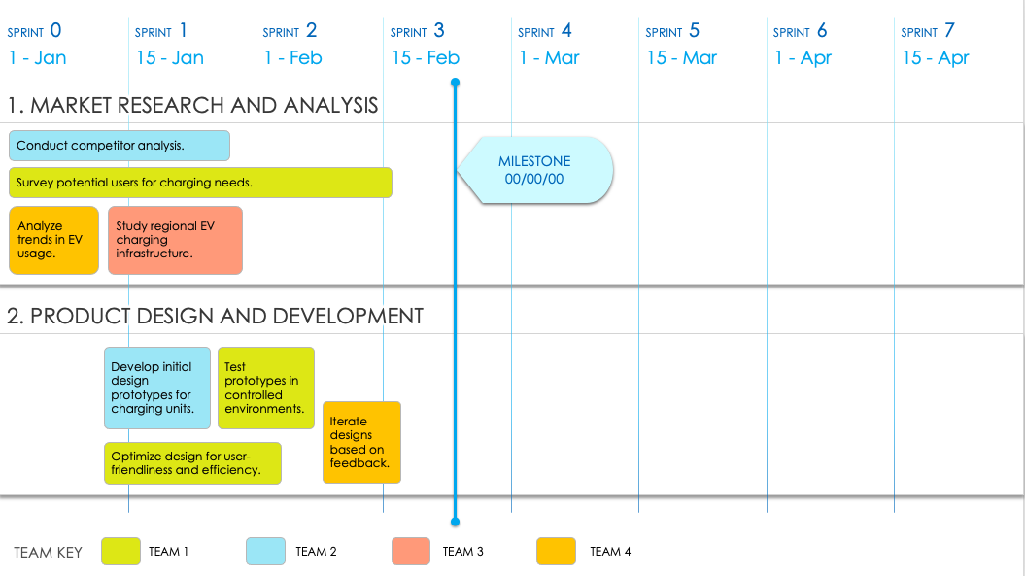
Agile Epic Roadmap Template
When to Use This Template: This Agile epic roadmap template is ideal for planning and tracking the execution of Agile epics over multiple sprints. It helps teams visualize progress and align their efforts with a project’s timeline.
Notable Template Features: Available with or without example text, this template includes a Gantt chart timeline, broken down into sprint-by-sprint columns. This format helps you plan and monitor epic progress throughout a project’s lifecycle.
TO USE THIS TEMPLATE:
Adjust number of Sprints to meet your plan.
Enter Sprint Start Dates.
Apply Teams or Team Members to the Team Key.
Duplicate the initial slide with Dates and Teams to represent each Phase / Category.
Enter Tasks and Milestones.

Slide 2
SPRINT 0
SPRINT 1
SPRINT 2
SPRINT 3
SPRINT 4
SPRINT 5
SPRINT 6
SPRINT 7
00/00
00/00
00/00
00/00
00/00
00/00
00/00
00/00
1. TEXT
MILESTONE
00/00/00
2. TEXT
TEAM KEY
TEAM 1
TEAM 2
TEAM 3
TEAM 4

Slide 3
DISCLAIMER Any articles, templates, or information provided by Smartsheet on the website are for reference only. While we strive to keep the information up to date and correct, we make no representations or warranties of any kind, express or implied, about the completeness, accuracy, reliability, suitability, or availability with respect to the website or the information, articles, templates, or related graphics contained on the website. Any reliance you place on such information is therefore strictly at your own risk.

