Slide 1
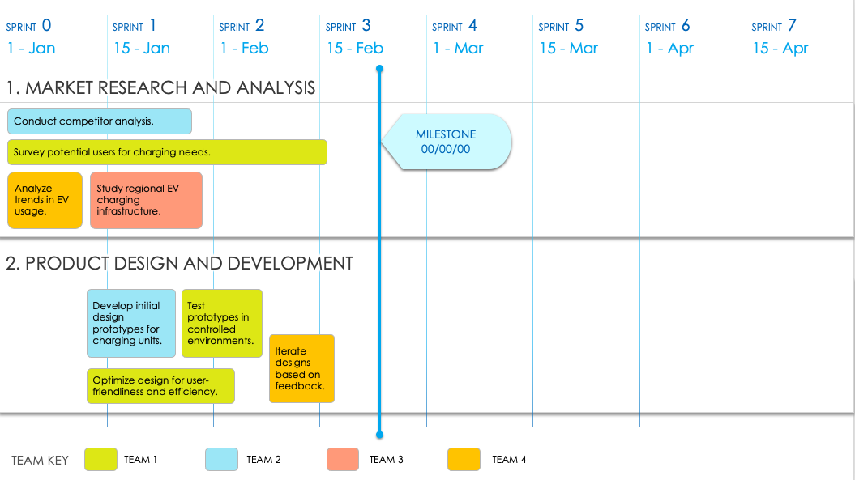
Agile Epic Roadmap Template – Example
When to Use This Template: This Agile epic roadmap template is ideal for planning and tracking the execution of Agile epics over multiple sprints. It helps teams visualize progress and align their efforts with a project’s timeline.
Notable Template Features: Available with or without example text, this template includes a Gantt chart timeline, broken down into sprint-by-sprint columns. This format helps you plan and monitor epic progress throughout a project’s lifecycle.
TO USE THIS TEMPLATE:
Adjust number of Sprints to meet your plan.
Enter Sprint Start Dates.
Apply Teams or Team Members to the Team Key.
Duplicate the initial slide with Dates and Teams to represent each Phase / Category.
Enter Tasks and Milestones.

Slide 2
SPRINT 0
SPRINT 1
SPRINT 2
SPRINT 3
SPRINT 4
SPRINT 5
SPRINT 6
SPRINT 7
1 - Jan
15 - Jan
1 - Feb
15 - Feb
1 - Mar
15 - Mar
1 - Apr
15 - Apr
1. MARKET RESEARCH AND ANALYSIS
Conduct competitor analysis.
MILESTONE
00/00/00
Survey potential users for charging needs.
Analyze trends in EV usage.
Study regional EV charging infrastructure.
2. PRODUCT DESIGN AND DEVELOPMENT
Develop initial design prototypes for charging units.
Test prototypes in controlled environments.
Iterate designs based on feedback.
Optimize design for user-friendliness and efficiency.
TEAM KEY
TEAM 1
TEAM 2
TEAM 3
TEAM 4

Slide 3
SPRINT 0
SPRINT 1
SPRINT 2
SPRINT 3
SPRINT 4
SPRINT 5
SPRINT 6
SPRINT 7
1 - Jan
15 - Jan
1 - Feb
15 - Feb
1 - Mar
15 - Mar
1 - Apr
15 - Apr
3. SOFTWARE DEVELOPMENT FOR CHARGING STATIONS
Develop user interface for charging stations.
Create monitoring system for station status.
MILESTONE
00/00/00
Integrate payment processing system.
Implement remote troubleshooting capabilities.
4. MOBILE APP DEVELOPMENT
Design user-friendly app interface.
Integrate app with charging stations.
Add features like location finder, booking, and payment.
Ensure security measures for user data.
TEAM KEY
TEAM 1
TEAM 2
TEAM 3
TEAM 4

Slide 4
SPRINT 0
SPRINT 1
SPRINT 2
SPRINT 3
SPRINT 4
SPRINT 5
SPRINT 6
SPRINT 7
1 - Jan
15 - Jan
1 - Feb
15 - Feb
1 - Mar
15 - Mar
1 - Apr
15 - Apr
5. INFRASTRUCTURE AND DEPLOYMENT PLANNING
Identify strategic locations for charging stations.
MILESTONE
00/00/00
Plan logistics for station installation.
Coordinate with local authorities for permits.
Develop maintenance and servicing schedules.
6. MARKETING AND BRANDING
Create branding strategy.
Develop marketing materials and website.
Plan launch event and promotional activities.
Initiate social media campaigns.
TEAM KEY
TEAM 1
TEAM 2
TEAM 3
TEAM 4

Slide 5
SPRINT 0
SPRINT 1
SPRINT 2
SPRINT 3
SPRINT 4
SPRINT 5
SPRINT 6
SPRINT 7
1 - Jan
15 - Jan
1 - Feb
15 - Feb
1 - Mar
15 - Mar
1 - Apr
15 - Apr
7. TESTING AND QUALITY ASSURANCE
Conduct field tests for charging stations.
MILESTONE
00/00/00
Perform app testing on various devices.
Ensure compliance with safety standards.
Gather user feedback for improvements.
8. LAUNCH AND POST-LAUNCH ACTIVITIES
Officially launch charging stations and app.
Monitor initial user interactions and feedback.
Plan for expansion and new feature additions.
Implement continuous improvement process.
TEAM KEY
TEAM 1
TEAM 2
TEAM 3
TEAM 4

Slide 6
DISCLAIMER Any articles, templates, or information provided by Smartsheet on the website are for reference only. While we strive to keep the information up to date and correct, we make no representations or warranties of any kind, express or implied, about the completeness, accuracy, reliability, suitability, or availability with respect to the website or the information, articles, templates, or related graphics contained on the website. Any reliance you place on such information is therefore strictly at your own risk.

